Slide 1
Hand Tracking Glove
Presented by Daniel Hamilton (EE)
Consulting Engineer - Shantanu Gulgule (EE)

Slide 2
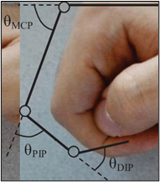
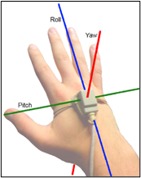
Introduction
The glove aims to capture bends in MCP and PIP finger joints and orientation of the hand.
Wirelessly transfers raw sensor data to Bluetooth devices.
Practical applications include sign language interpretation, expressive controllers for musical performances, and gaming.
Figure 1: MCP and PIP finger joints (left) and 3 axes of hand orientation (right).

Slide 3
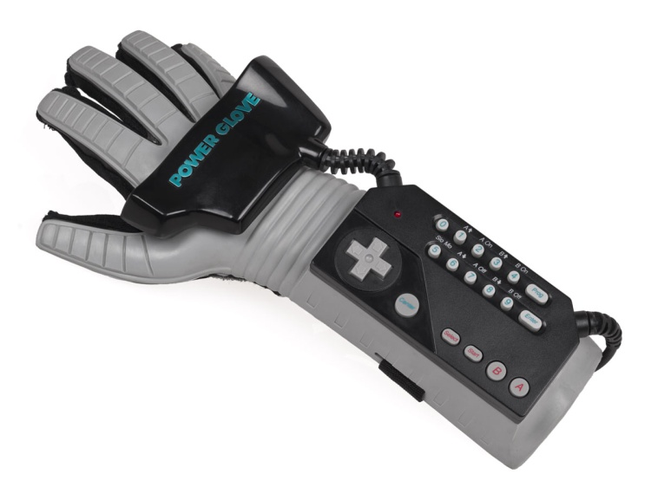
What’s out there?
This project was inspired by the Nintendo Power Glove, which was released in 1989.
Finger bend sensors allowed for 4 positions per finger on 4 fingers.
Triangulation of 2 ultrasonic speakers on the glove to capture yaw and roll (not pitch).
Notoriously difficult to use - hopefully not true for my glove!
Figure 2: The Nintendo Power Glove.

Slide 4
Description - Hardware
Flex sensors that change resistance as they bend on each MCP and PIP joint.
Differential amplifiers and low-pass filters to increase ADC steps in target voltage range and to reduce noise.
Accelerometer, gyroscope, and magnetometer sensors for use in attitude and heading calculation.
Serial to Bluetooth module for transmitting data wirelessly.
Li-ion rechargeable battery and voltage regulator as device power source.
Battery charger circuit - Constant Current, Constant Voltage (CCCV).
Speaker and amplifiers to play a short tune when glove is unplugged from charger, plugged into charger, or fully charged.
Waveform generator that selects frequencies in a 4-note tune using a 555 timer, a 4029 up/down counter, a 4051 demux, and some additional logic gates.
LCD to display battery charge percentage and Bluetooth connection status.

Slide 5
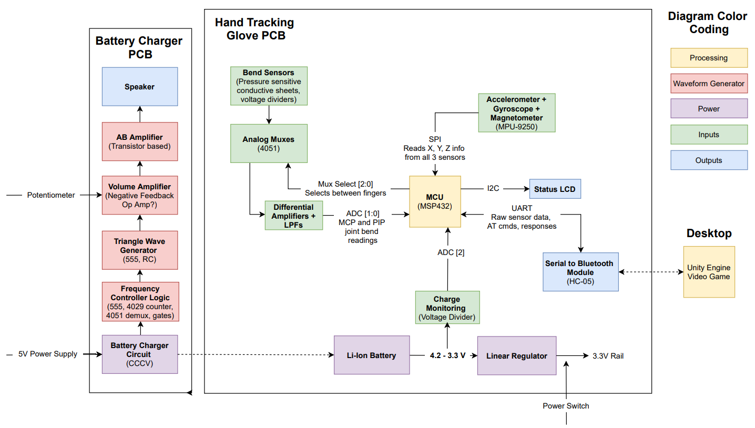
Hardware Diagram
Figure 3: High-level hardware diagram.

Slide 6
Description - Software
Glove - MSP432
Collect all sensor data and transfer the data to the desktop application with minimum latency - I2C, UART, ADC, timers, interrupts.
Ability to recognize Bluetooth connection and disconnection.
Estimate remaining battery charge based on the battery’s discharge voltage diagram - ADC.
Desktop Application
Connect, disconnect, and decode messages transferred over Bluetooth.
Calculate hand orientation using the gyroscope while compensating for gyro drift with accelerometer and magnetometer.
Make a video game in Unity/C# that can be controlled using the processed glove inputs.

Slide 7
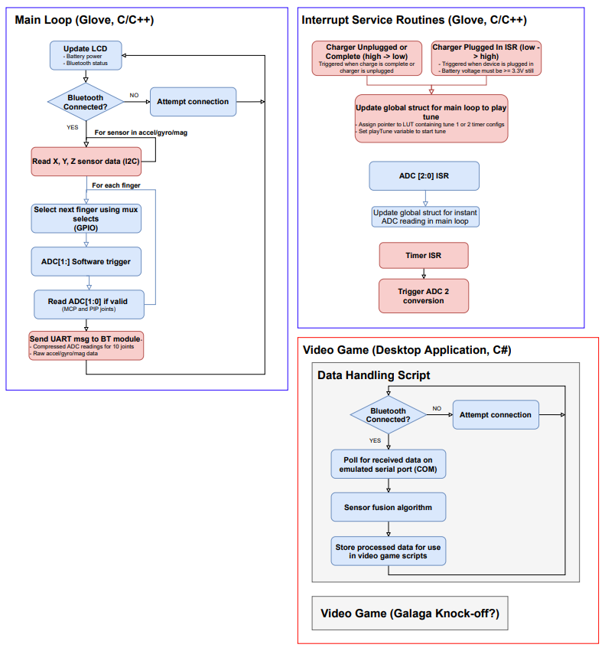
Software Flowchart
Figure 4: High-level software flowchart.
Notes:
Glove’s primary goals are to collect/transfer raw data to the desktop with minimum latency.
Desktop application performs most data processing.
Processed data controls the video game demo.

Slide 8
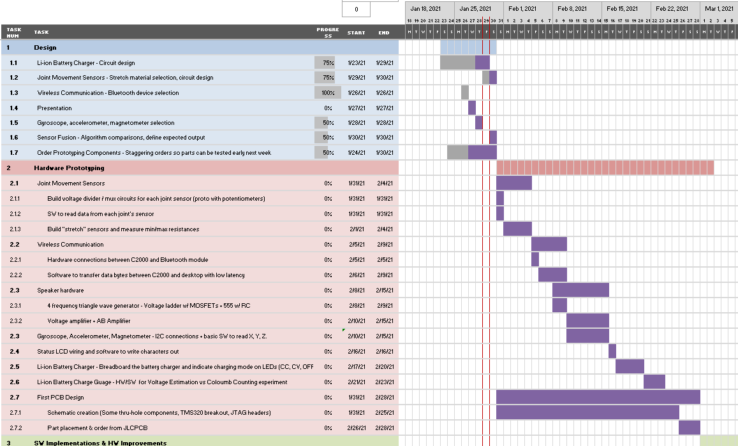
Gantt Chart
First few weeks of Gantt chart shown to the right.
~3 weeks of research & design
~4 weeks of HW Prototyping (PCB 1 design at end)
~4 weeks of SW Implementation & HW Improvements (PCB 2 design at end)
~3 weeks of polish and stretch goals (if time allows)
Figure 5: Gantt chart for project timeline.

Slide 9
Questions

